Slide 1
Course: Programming Fundamentals
4.00 Credit Hours, Fall 2018,
Graduate Program
Instructor: Maryam Ehsan
SESSION 2

Slide 2
Today’s lecture outline
Menu driven program using functions
Function call by value
Scope of variable
Local
Global

Slide 3
Menu driven program using functions
Menu is
Factorial of a number
Prime number
Even or odd
Exit

Slide 4
Passing Values between Functions
The mechanism used to convey information to the function is the ‘argument’ or ‘parameter’
You have already used the arguments in the printf( ) and scanf( ) function
the format string and the list of variables used inside the parentheses in these functions are arguments

Slide 5
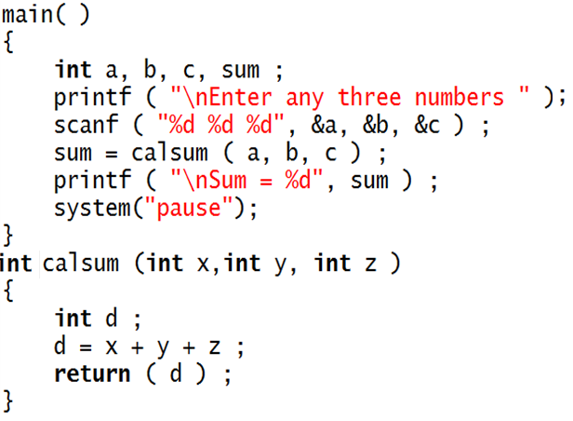
Example program
a
5
b
6
c
2
sum
13
Sum = 13
x
5
Program Output
y
6
Enter any three number:
5
6
2
z
2
Sum = 13
d
13
Go to program
Press any key to continue . . .

Slide 6
Points to remember
The variables a, b and c are called ‘actual arguments’, whereas the variables x, y and z are called ‘formal arguments’
Any number of arguments can be passed to a function being called. However, the type, order and number of the actual and formal arguments must always be same
The return statement serves two purposes
On executing the return statement it immediately transfers the control back to the calling program
It returns the value present in the parentheses after return, to the calling program

Slide 7
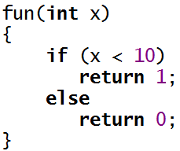

Cont.
There is no restriction on the number of return statements that may be present in a function.
The return value should be accepted in the calling function

Slide 8
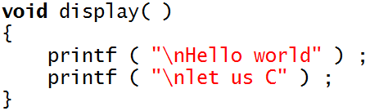

If called function should not return any value, the it must be mentioned by using the keyword void
A function can return only one value at a time. Thus, the following statements are invalid.

Slide 9
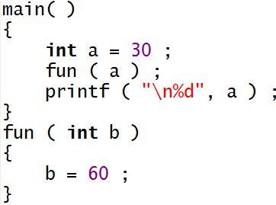
Cont.
If the value of a formal argument is changed in the called function, the corresponding change does not take place in the calling function. For example
a
30
b
60

Slide 10
Menu driven program using functions call by value
Menu is
Factorial of a number
Prime number
Even or odd
Exit

Slide 11
Variable Scope
Variable scope identifies and determines the life span of any variable in any programming language
When a variable loses its scope, it means its data value is lost
Common types of variables scopes in C/C++,
local
global

Slide 12
Local Scope
You have unknowingly been using local scope variables
Scope of variable a, b, c and sum
Scope of variable x, y, z and d

Slide 13
Global variable
Locally scoped variables can be reused in other functions without harming one another’s contents
You might want to share data between functions
To support the concept of sharing data, you can create and use global variables

Slide 14
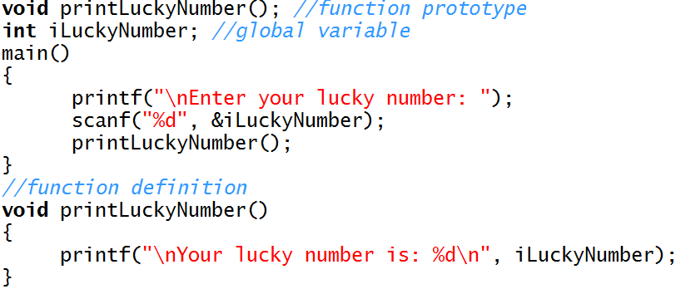
Example program
iLuckyNumber
printLuckyNumber()
{
}
main()
{
}

